Slide 1
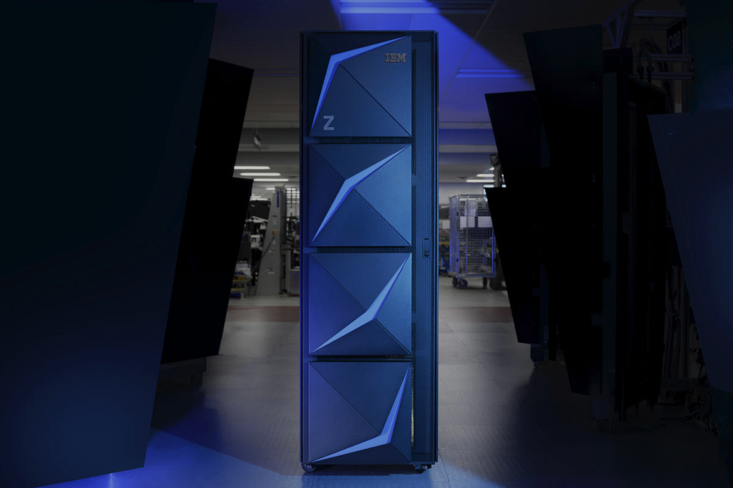

Z DevOps
Discovery and Design workshop
DevOps Acceleration Program
Module
Introduction to zAppBuild

Slide 2








High-Level Architecture Overview - CI workflow / Pipeline build
Pipeline orchestrator
z/OS Pipeline Build
Environment
<CICD>.COBOL.
SOURCE/COPY/LOAD
Start Pipeline
DBB WebApp (Linux)
Dependency Metadata
Build Results History
Status, logs and links to reports
Retrieve status & logs
Manage dependencies
DBB Toolkit
Main Repository
Clone to USS
Agent
USS
Groovy Build scripts
Scan, impact analysis, copy to compile, link-edit & report, binaries
PDSE
Git Server
Invoke DBB Build Script
Retrieve status & logs

Slide 3
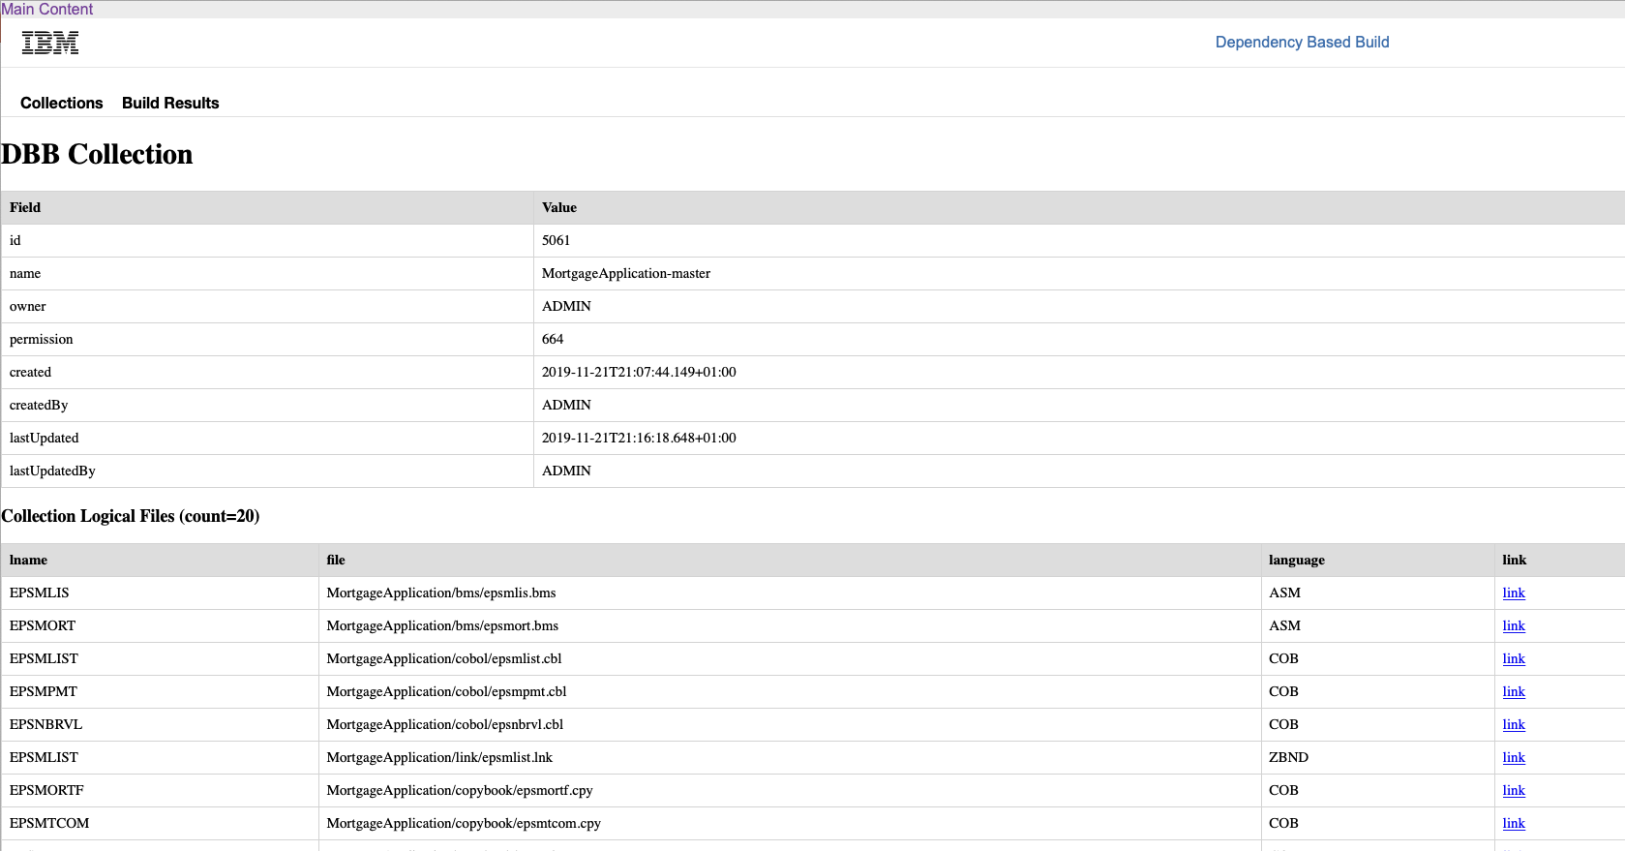
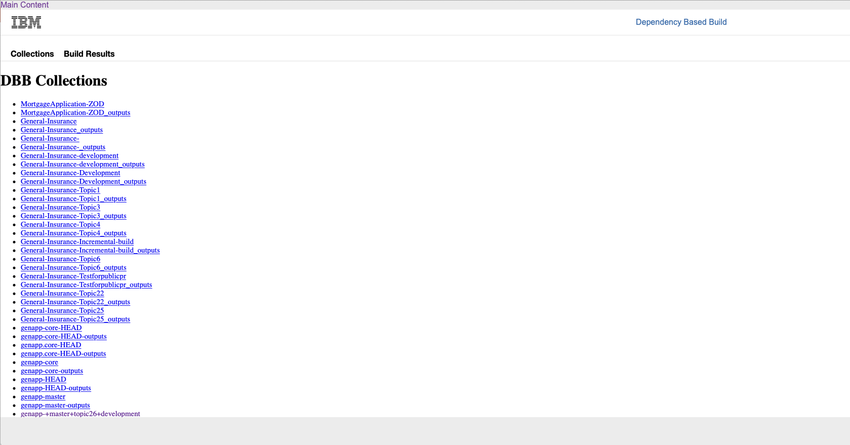
DBB WebApp to persist Metadata-Information

Slide 4
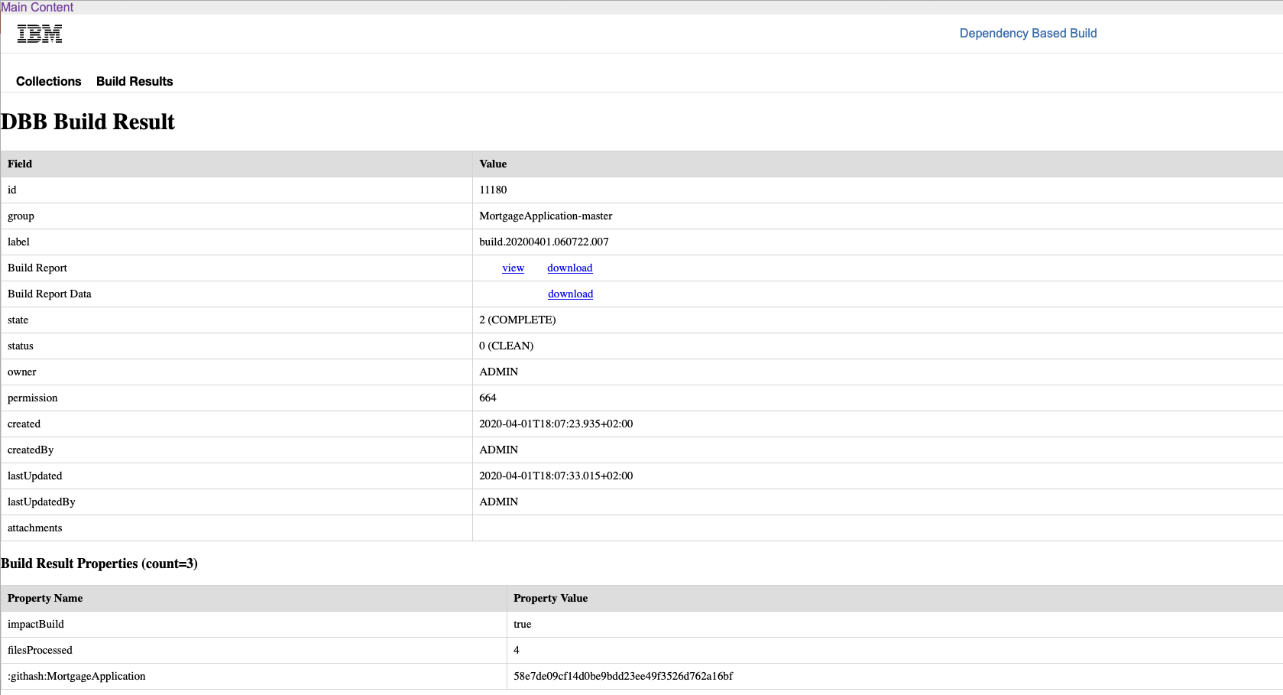
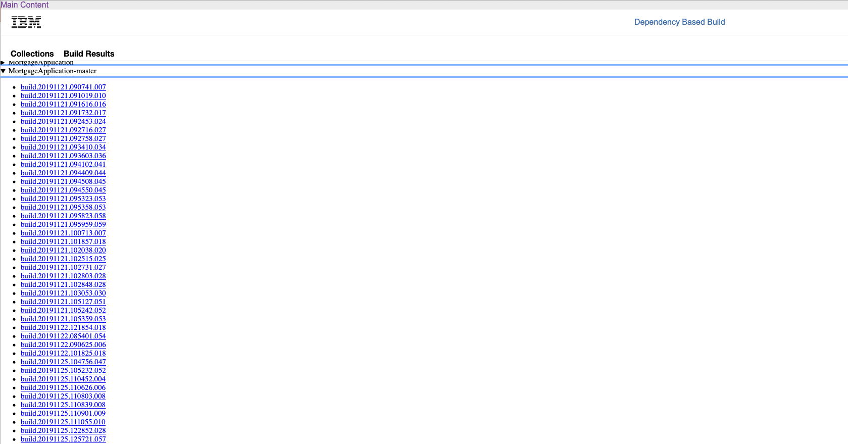
DBB WebApp to persist Build Results

Slide 5
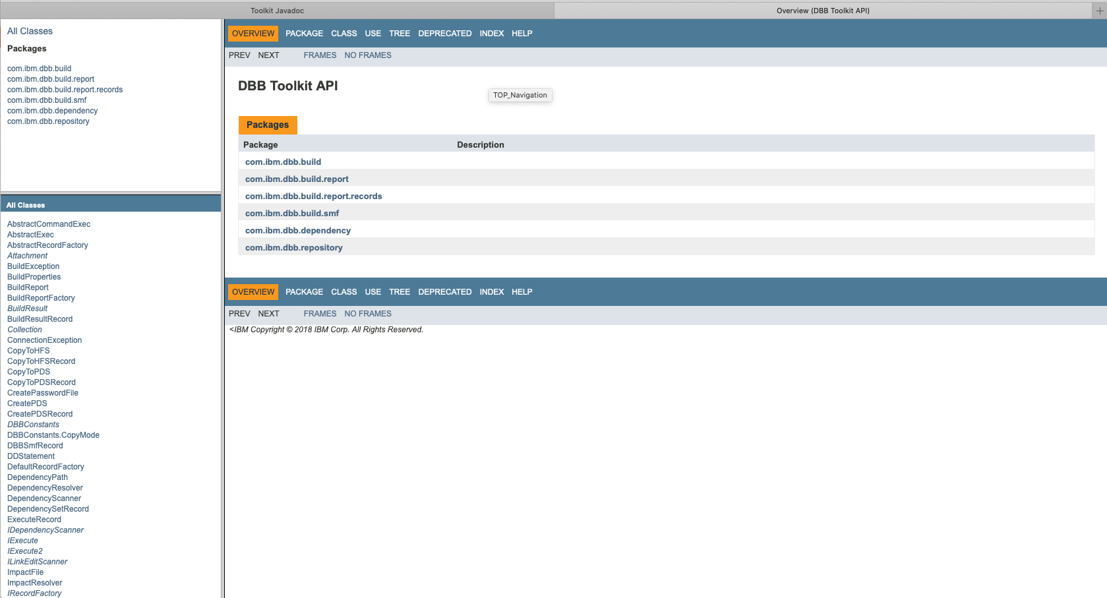
The API to plum the build

Slide 6
How to Build Using Dependency Based Build
This module will illustrate the following:
What is a build?
What is the zAppBuild framework?
zAppBuild Highlights
zAppBuild building blocks
Look at the sample zAppBuild

Slide 7
What Is a Build?
In DBB Terms:
A way to compile/link traditional mainframe applications
Uses open tools such as Git and Groovy
Relies on additional z/OS Groovy APIs provided by DBB
Also handle pre-compilation, and other tasks (e.g. run unit test)
Can be easily incorporated into an automated CI/CD pipeline

Slide 8
What Is the zAppBuild Framework?
A generic build solution for z/OS applications
Used to build all z/OS applications
Contains high-level enterprise-wide settings
Enables use of application-level settings to provide necessary setting overrides for each application

Slide 9
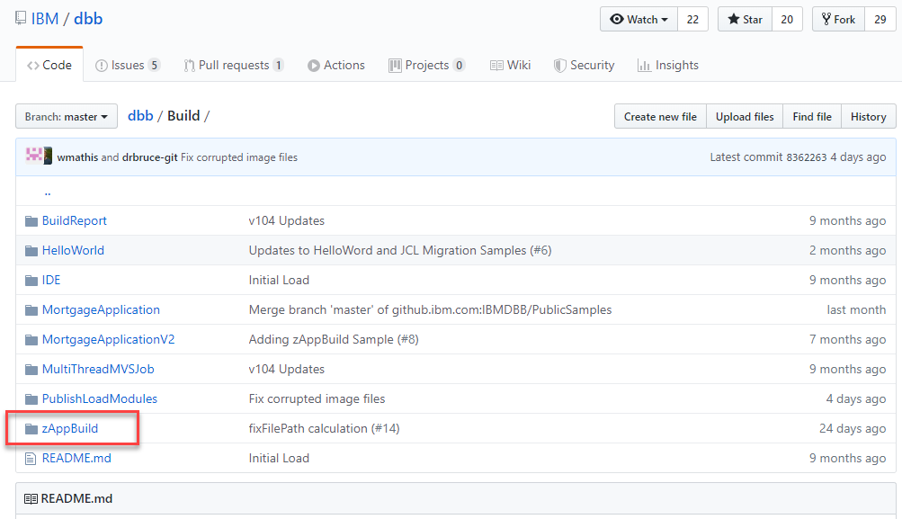
What Is the zAppBuild Framework?
A generic build solution for z/OS applications
Used to build all z/OS applications
Contains high-level enterprise-wide settings
Enables use of application-level settings to provide necessary setting overrides for each application
Delivered as a public sample in Github
https://github.com/IBM/dbb-zappbuild
https://github.com/ibm/dbb

Slide 10
zAppBuild Highlights
Supports the following languages out of the box:
Assembler
BMS and MFS
COBOL
PL/I
Link Cards
PSB, DBD
Supported build actions:
Single Program – Build a single program in the application
List of Programs – Build a list of programs provided by a text file
Full Build – Build all programs (or buildable files) of an application
Impact Build – Build only the programs impacted by source files that have changed since the last successful build
Scan Only – Skip the actual building and only scan source files for dependency data

Slide 11
High-level view on zAppBuild
Initialize Build
Create Build List
Process Build List
Finalize Build

Slide 12
zAppBuild workflow
Initialize Build
Load properties
Initialize Build Report and build result
Create Data Sets if needed
Connect to WebApp
Initialize Collection if needed
List of files to build
Pipeline build only

Slide 13
zAppBuild workflow
Initialize Build
Create Build List
Load properties
Initialize Build Report and build result
Create Data Sets if needed
Process build option
User build, full build, impact, etc.
Scan changed files and update collection
Perform impact analysis
Connect to WebApp
Initialize Collection if needed
List of files to build
Pipeline build only

Slide 14
zAppBuild workflow
Initialize Build
Create Build List
Process Build List
Load properties
Initialize Build Report and build result
Create Data Sets if needed
Process build option
User build, full build, impact, etc.
Find appropriate language script to run
Run Language script
Run additional processes (file level)
Scan changed files and update collection
Perform impact analysis
Connect to WebApp
Initialize Collection if needed
List of files to build
Pipeline build only

Slide 15
zAppBuild workflow
Initialize Build
Create Build List
Process Build List
Finalize Build
Load properties
Initialize Build Report and build result
Create Data Sets if needed
Process build option
User build, full build, impact, etc.
Find appropriate language script to run
Run Language script
Run additional processes (file level)
Run additional processes (build level)
Mark Build as finished with status
Add git hashes
Upload logs and reports
Scan changed files and update collection
Perform impact analysis
Connect to WebApp
Initialize Collection if needed
List of files to build
Pipeline build only

Slide 16
zAppBuild Highlights
Configuration
Scripts
Main Build script
Language scripts
Utility scripts
Configuration files
Utils.groovy
file.properties
Cobol.groovy
application.properties
datasets.properties
assembler.groovy
Build.groovy
build.properties
pli.groovy

Slide 17
zAppBuild Building Blocks
Implement your processing logic (or choose / customize from the default behaviors provided)
Express your configuration and your rules
Build entry point
Application specific rules
General rules
Git Utilities
Language scripts
Impact Utilities
Build Utilities
DBB Toolkit APIs

Slide 18
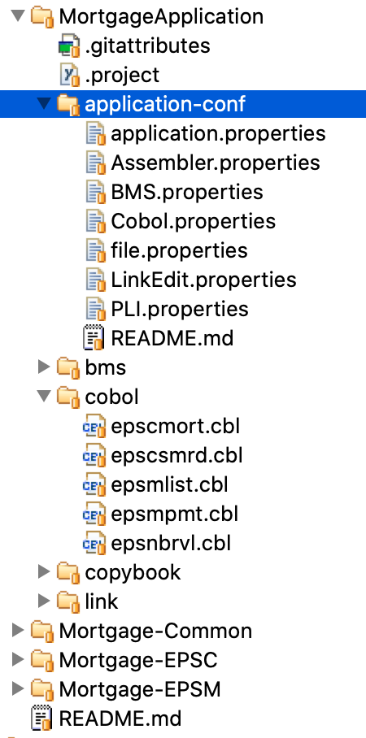
Necessary Application-level configurations
Application configuration application.properties provides general settings and information about the application component
Script Mapping file.properties declares which files should be processed by the build and by which language script.
Language-scripts provide configurations for each application component

Slide 19
Application-conf file.properties
Manages the mapping to the language scripts
Provides file level overwrites of properties
# Application script mappings and file property overrides
#
# Script mappings for all application programs
dbb.scriptMapping = Assembler.groovy :: **/*.asm
dbb.scriptMapping = BMS.groovy :: **/*.bms
dbb.scriptMapping = Cobol.groovy :: **/*.cbl
dbb.scriptMapping = LinkEdit.groovy :: **/*.lnk
dbb.scriptMapping = PLI.groovy :: **/*.pli
#
# Need to build epsnbrvl.cbl first during cobol builds
cobol_fileBuildRank = 1 :: **/cobol/epsnbrvl.cbl
#
# Skip creating a load module for these programs as they will be statically linked to other programs
cobol_linkEdit = false :: **/cobol/epsnbrvl.cbl, **/cobol/epsmlist.cbl
#
# epsmlist needs to compile as CICS but does not have EXEC CICS statements
# so is not automatically flagged as CICS by dependency scanner
isCICS = true :: **/cobol/epsmlist.cbl

Slide 20
Troubleshooting
zAppBuild has a built-in tracing option --verbose, which can be used in user and pipeline builds
*** Building file MortgageApplication/cobol/epscmort.cbl
*** Creating dependency resolver for MortgageApplication/cobol/epscmort.cbl with [{"library": "SYSLIB", "searchPath": [ {"sourceDir": "/u/dbehm/demo/MortgageApplication", "directory": "MortgageApplication/copybook"} ] }] rules
*** Resolution rules for MortgageApplication/cobol/epscmort.cbl:
{"library":"SYSLIB","searchPath":[{"sourceDir":"\/u\/dbehm\/demo\/MortgageApplication","directory":"MortgageApplication\/copybook"}]}
*** Physical dependencies for MortgageApplication/cobol/epscmort.cbl:
{"lname":"DFHAID","library":"SYSLIB","category":"COPY","resolved":false}
{"lname":"EPSMORT","library":"SYSLIB","category":"COPY","resolved":false}
{"sourceDir":"\/u\/dbehm\/demo\/MortgageApplication","lname":"EPSMTINP","library":"SYSLIB","file":"MortgageApplication\/copybook\/epsmtinp.cpy","category":"COPY","resolved":true}
{"sourceDir":"\/u\/dbehm\/demo\/MortgageApplication","lname":"EPSNBRPM","library":"SYSLIB","file":"MortgageApplication\/copybook\/epsnbrpm.cpy","category":"COPY","resolved":true}
{"lname":"SQLCA","library":"SYSLIB","category":"SQL INCLUDE","resolved":false}
{"lname":"EPSNBRVL","library":"SYSLIB","category":"CALL","resolved":false}
{"lname":"EPSMLIST","library":"SYSLIB","category":"LINK","resolved":false}
Cobol compiler parms for MortgageApplication/cobol/epscmort.cbl = LIB,CICS,SQL
Notes:
https://github.ibm.com/zDevOps-Acceleration/FAQ-and-HowTos/blob/master/dbb/LoggingWithLog4j.md

Slide 21
Troubleshooting
DBB Toolkit can produce a detailed trace via log4j :
DEBUG 2020-01-16 14:27:25,786 10665 com.ibm.dbb.build.internal.ProductRegistrationChecker [main] Registration product = {"productId":"5655-AC6","featureName":"DBB","productName":"IBM APP DLIV FND"}
DEBUG 2020-01-16 14:27:25,786 10665 com.ibm.dbb.build.internal.Utils [main] bpxwdyn: alloc dd(SYSIN) dsn(DBEHM.FPETS.COBSRC(EPSCMORT)) shr
DEBUG 2020-01-16 14:27:25,805 10684 com.ibm.dbb.build.internal.Utils [main] bpxwdyn: alloc dd(SYSPRINT) cyl space(5,5) unit(vio) blksize(133) lrecl(133) recfm(f,b) new
DEBUG 2020-01-16 14:27:25,815 10694 com.ibm.dbb.build.internal.Utils [main] bpxwdyn: alloc dd(SYSMDECK) cyl space(5,5) unit(vio) blksize(80) lrecl(80) recfm(f,b) new
DEBUG 2020-01-16 14:27:25,825 10704 com.ibm.dbb.build.internal.Utils [main] bpxwdyn: alloc dd(SYSUT1) cyl space(5,5) unit(vio) blksize(80) lrecl(80) recfm(f,b) new
DEBUG 2020-01-16 14:27:25,835 10714 com.ibm.dbb.build.internal.Utils [main] bpxwdyn: alloc dd(SYSUT2) cyl space(5,5) unit(vio) blksize(80) lrecl(80) recfm(f,b) new
DEBUG 2020-01-16 14:27:25,844 10723 com.ibm.dbb.build.internal.Utils [main] bpxwdyn: alloc dd(SYSUT3) cyl space(5,5) unit(vio) blksize(80) lrecl(80) recfm(f,b) new
DEBUG 2020-01-16 14:27:25,853 10732 com.ibm.dbb.build.internal.Utils [main] bpxwdyn: alloc dd(SYSUT4) cyl space(5,5) unit(vio) blksize(80) lrecl(80) recfm(f,b) new
DEBUG 2020-01-16 14:27:25,862 10741 com.ibm.dbb.build.internal.Utils [main] bpxwdyn: alloc dd(SYSUT5) cyl space(5,5) unit(vio) blksize(80) lrecl(80) recfm(f,b) new
DEBUG 2020-01-16 14:27:25,872 10751 com.ibm.dbb.build.internal.Utils [main] bpxwdyn: alloc dd(SYSUT6) cyl space(5,5) unit(vio) blksize(80) lrecl(80) recfm(f,b) new
DEBUG 2020-01-16 14:27:25,881 10760 com.ibm.dbb.build.internal.Utils [main] bpxwdyn: alloc dd(SYSUT7) cyl space(5,5) unit(vio) blksize(80) lrecl(80) recfm(f,b) new
DEBUG 2020-01-16 14:27:25,891 10770 com.ibm.dbb.build.internal.Utils [main] bpxwdyn: alloc dd(SYSUT8) cyl space(5,5) unit(vio) blksize(80) lrecl(80) recfm(f,b) new
DEBUG 2020-01-16 14:27:25,900 10779 com.ibm.dbb.build.internal.Utils [main] bpxwdyn: alloc dd(SYSUT9) cyl space(5,5) unit(vio) blksize(80) lrecl(80) recfm(f,b) new
DEBUG 2020-01-16 14:27:25,911 10790 com.ibm.dbb.build.internal.Utils [main] bpxwdyn: alloc dd(SYSUT10) cyl space(5,5) unit(vio) blksize(80) lrecl(80) recfm(f,b) new
DEBUG 2020-01-16 14:27:25,920 10799 com.ibm.dbb.build.internal.Utils [main] bpxwdyn: alloc dd(SYSUT11) cyl space(5,5) unit(vio) blksize(80) lrecl(80) recfm(f,b) new
DEBUG 2020-01-16 14:27:25,929 10808 com.ibm.dbb.build.internal.Utils [main] bpxwdyn: alloc dd(SYSUT12) cyl space(5,5) unit(vio) blksize(80) lrecl(80) recfm(f,b) new
DEBUG 2020-01-16 14:27:25,939 10818 com.ibm.dbb.build.internal.Utils [main] bpxwdyn: alloc dd(SYSUT13) cyl space(5,5) unit(vio) blksize(80) lrecl(80) recfm(f,b) new
DEBUG 2020-01-16 14:27:25,948 10827 com.ibm.dbb.build.internal.Utils [main] bpxwdyn: alloc dd(SYSUT14) cyl space(5,5) unit(vio) blksize(80) lrecl(80) recfm(f,b) new
DEBUG 2020-01-16 14:27:25,958 10837 com.ibm.dbb.build.internal.Utils [main] bpxwdyn: alloc dd(SYSUT15) cyl space(5,5) unit(vio) blksize(80) lrecl(80) recfm(f,b) new
DEBUG 2020-01-16 14:27:25,967 10846 com.ibm.dbb.build.internal.Utils [main] bpxwdyn: alloc dd(SYSUT16) cyl space(5,5) unit(vio) blksize(80) lrecl(80) recfm(f,b) new
DEBUG 2020-01-16 14:27:25,977 10856 com.ibm.dbb.build.internal.Utils [main] bpxwdyn: alloc dd(SYSUT17) cyl space(5,5) unit(vio) blksize(80) lrecl(80) recfm(f,b) new
DEBUG 2020-01-16 14:27:25,986 10865 com.ibm.dbb.build.internal.Utils [main] bpxwdyn: alloc dd(SYSLIN) dsn(&&TEMPOBJ) cyl space(5,5) unit(vio) blksize(80) lrecl(80) recfm(f,b) new
DEBUG 2020-01-16 14:27:25,995 10874 com.ibm.dbb.build.internal.Utils [main] bpxwdyn: alloc dd(SYSLIB) dsn(DBEHM.FPETS.COPY) shr
DEBUG 2020-01-16 14:27:26,003 10882 com.ibm.dbb.build.internal.Utils [main] bpxwdyn: alloc dd(TMP00001) dsn(DBEHM.FPETS.BMS.COPY) shr
DEBUG 2020-01-16 14:27:26,010 10889 com.ibm.dbb.build.internal.Utils [main] bpxwdyn: alloc dd(TMP00002) dsn(CICSTS.V5R4.CICS.SDFHCOB) shr
DEBUG 2020-01-16 14:27:26,017 10896 com.ibm.dbb.build.internal.Utils [main] bpxwdyn: concat ddlist(SYSLIB,TMP00001,TMP00002)
DEBUG 2020-01-16 14:27:26,024 10903 com.ibm.dbb.build.internal.Utils [main] bpxwdyn: alloc dd(TASKLIB) dsn(COBOL.V6R1.SIGYCOMP) shr
DEBUG 2020-01-16 14:27:26,034 10913 com.ibm.dbb.build.internal.Utils [main] bpxwdyn: alloc dd(TMP00003) dsn(CICSTS.V5R4.CICS.SDFHLOAD) shr
DEBUG 2020-01-16 14:27:26,041 10920 com.ibm.dbb.build.internal.Utils [main] bpxwdyn: alloc dd(TMP00004) dsn(DB2.V12.SDSNLOAD) shr
DEBUG 2020-01-16 14:27:26,048 10927 com.ibm.dbb.build.internal.Utils [main] bpxwdyn: alloc dd(TMP00005) dsn(RDZ.V14R1.SFELLOAD) shr
DEBUG 2020-01-16 14:27:26,055 10934 com.ibm.dbb.build.internal.Utils [main] bpxwdyn: concat ddlist(TASKLIB,TMP00003,TMP00004,TMP00005)
DEBUG 2020-01-16 14:27:26,060 10939 com.ibm.dbb.build.internal.Utils [main] bpxwdyn: alloc dd(DBRMLIB) dsn(DBEHM.FPETS.DBRM(EPSCMORT)) shr
DEBUG 2020-01-16 14:27:26,067 10946 com.ibm.dbb.build.MVSExec [main] Executing 'IGYCRCTL' with the following parameters: (LIB,CICS,SQL), DD names: (), tasklib: true
DEBUG 2020-01-16 14:27:26,653 11532 com.ibm.dbb.build.MVSExec [main] RC: 4
Notes:
https://github.ibm.com/zDevOps-Acceleration/FAQ-and-HowTos/blob/master/dbb/LoggingWithLog4j.md

Slide 22
zAppBuild Summary
Free Sample in public Github
https://github.com/ibm/dbb
Use as starting point for customizing build environment
Separates properties from scripts

